Slide 1

Group 9: Electronic piano
Nguyen Ngoc Tu - 20194873

Slide 2

Problem statement
Overview: Piano is a popular musical instrument. In this project, you are asked to implement an application that provides GUI for the user to virtually play an electronic piano. Basic Knowledge: Data structure, Algorithms, Project Settings, and Music Specifications:
GUI: you can freely design your own GUI. However, since the basic aim of the project is to develop an application based on OOP, focusing on the interface is not required.
To implement this project, you just need some basic music knowledge. You don’t have to implement a mechanism to play sound, you can directly import libraries from any source.

Slide 3
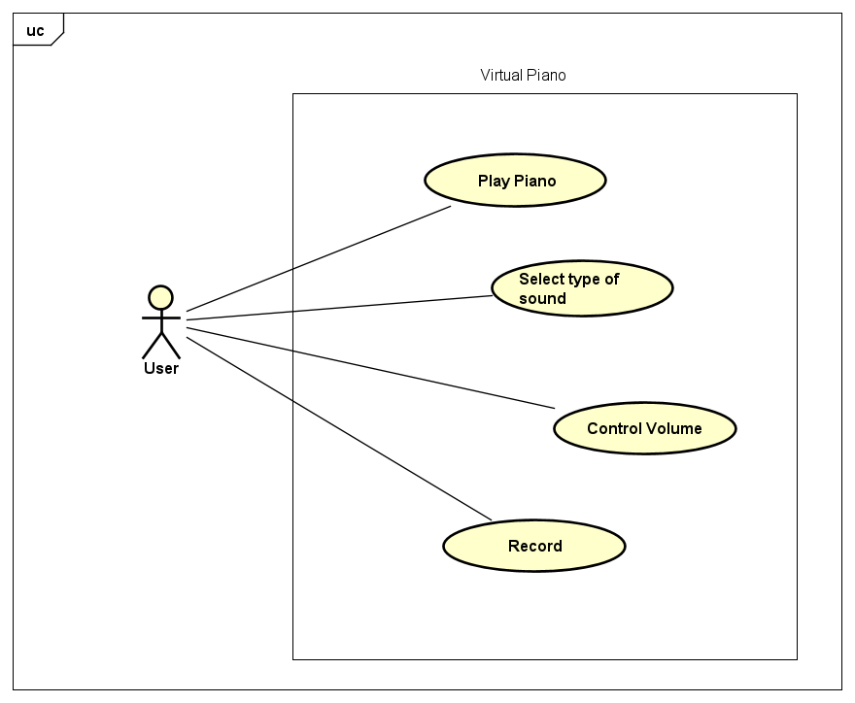
Use case diagram

Slide 4
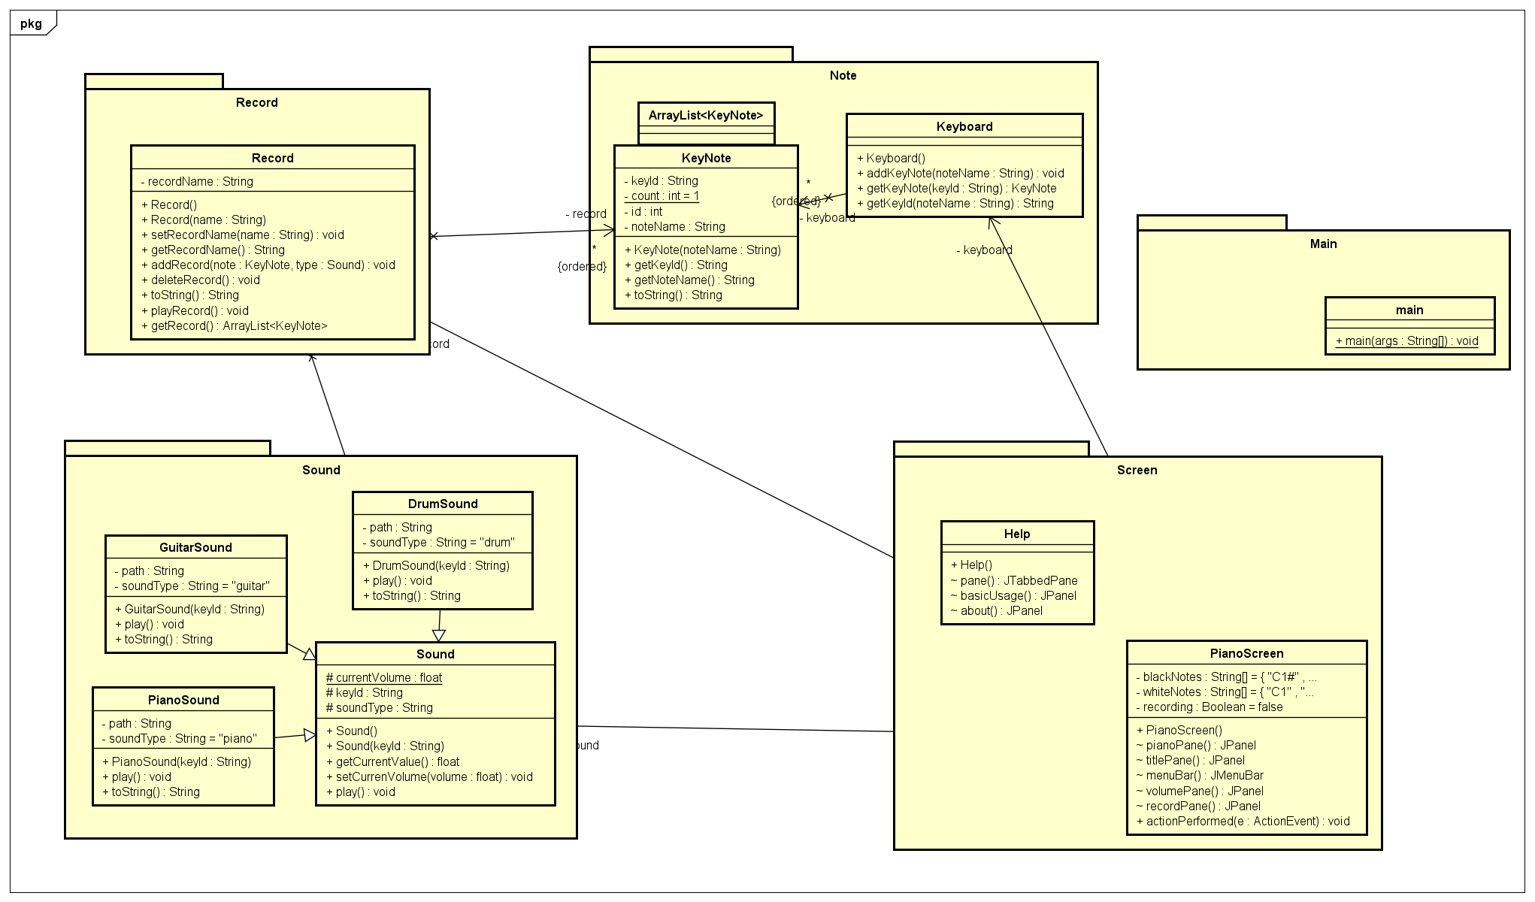
Class diagram

Slide 5
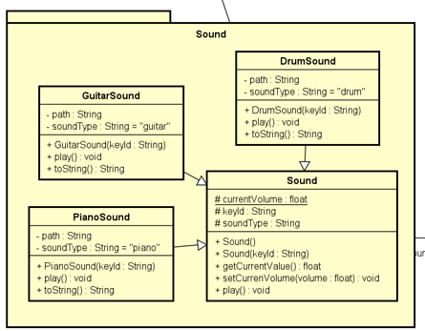
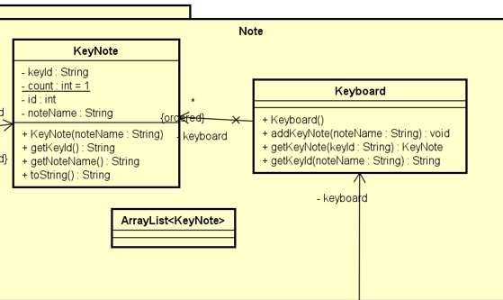
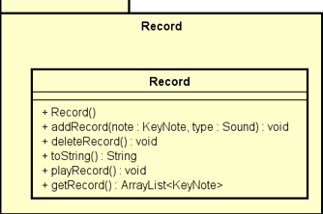

Slide 6
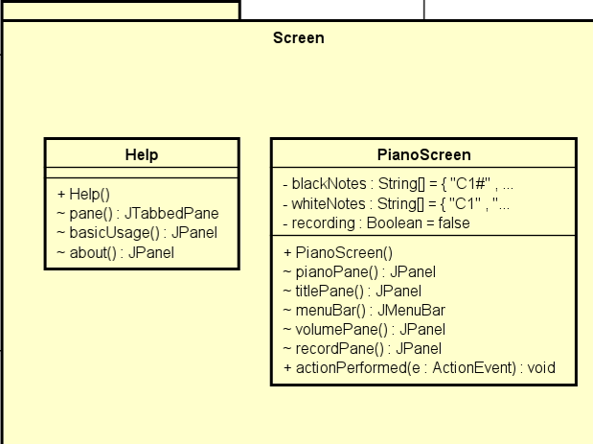
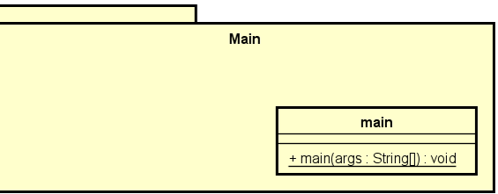
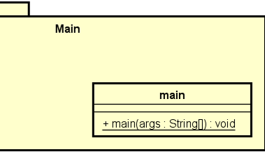

Slide 7
OOP techniques
1. Inheritance
Sound is superclass, PianoSound, GuitarSound and DrumSound is subclass.
2.Polymorphism
Method play() in Sound is overrided in PianoSound, GuitarSound and DrumSound.

Slide 8
OOP techniques
Aggregation | Composition
Class Keyboard uses class Keynote Class Record uses class Keynote and Sound | PianoScreen has class Keyboard, Sound, Record and class HelpScreen

Slide 9
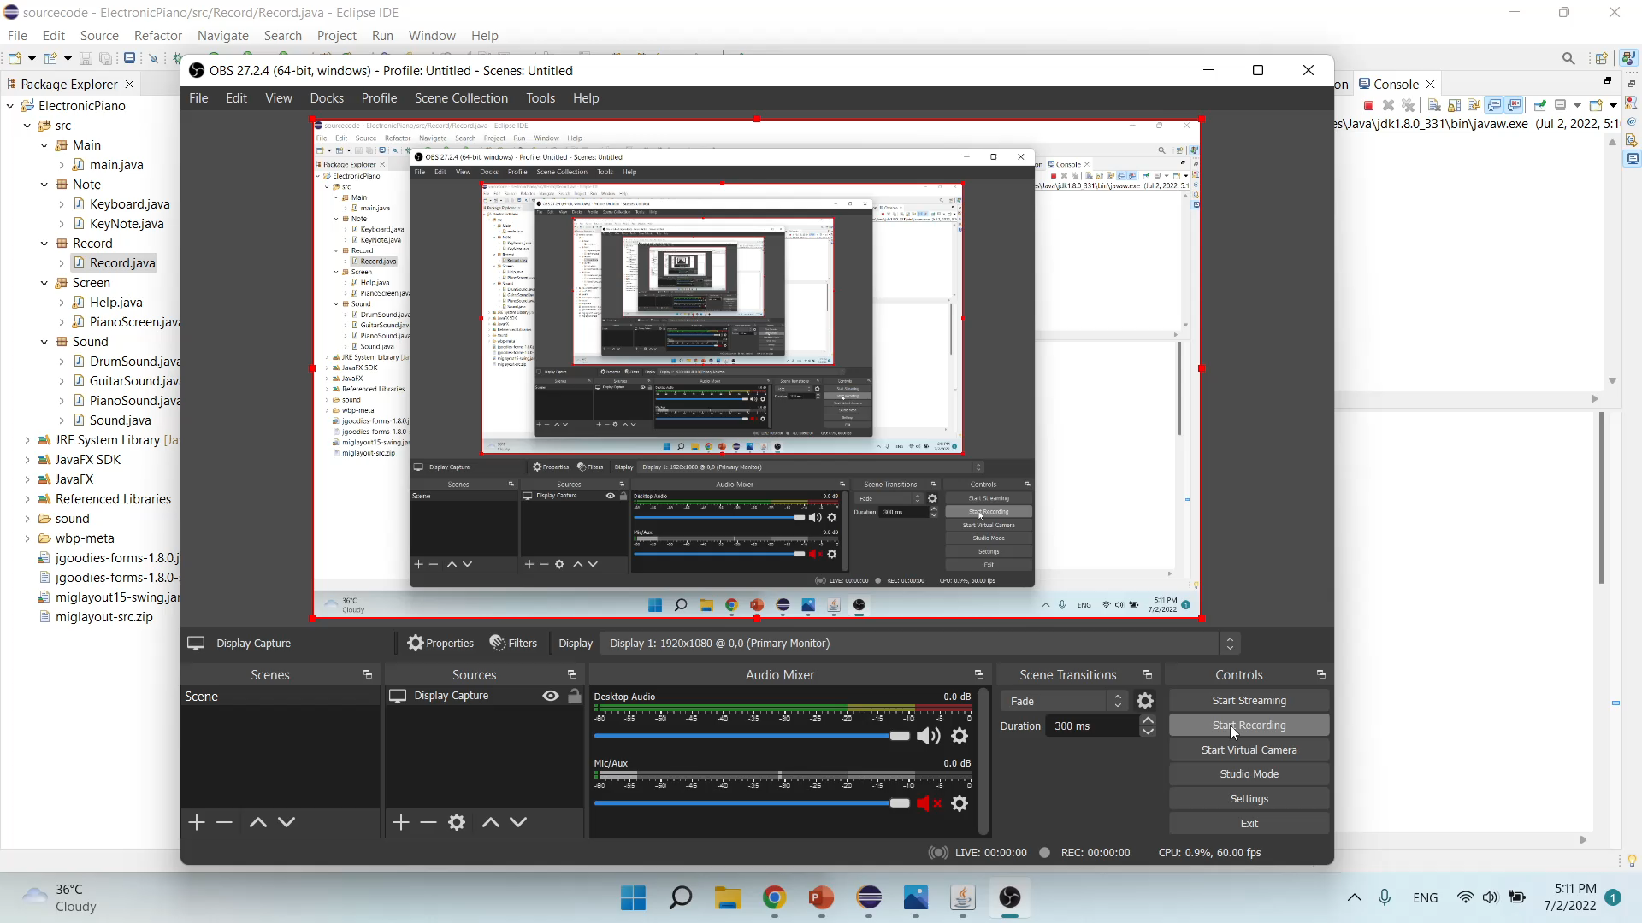
Demo scenario

